Slide 1









An Empirical Study on Using Large Language Models to Analyze
Software Supply Chain Security Failures
Tanmay Singla*
singlat@purdue.edu
Dharun Anandayuvaraj*
dananday@purdue.edu
Taylor R. Schorlemmer
tschorle@purdue.edu
Kelechi G. Kalu
kalu@purdue.edu
James C. Davis
davisjam@purdue.edu
∗Co-first authors
Notes:
Tanmay introduces himself, duality lab and introduces the paper.

Slide 2
Problem
Motivation: Increase in software supply chain attacks and failures
  12,000 attacks (2020 – 2021)
  88,000 attacks (2021-2022) [Sonatype’23]
Prior solutions: Learning through open-source intelligence
Problem with solution: Current approaches include manual analysis of past failures
  Expensive and time consuming
Notes:
As reusable libraries and frameworks become more available, software engineers shifted to more software reuse. Software applications now commonly rely on external code components, often referred to as dependencies leading to different software supply chains
Increase in failures: This is because verifying the software by each vendor/developer becomes time consuming and challenging.
Open-Source Intelligence are publicly available articles and literature and used by governmental bodies, military institutions, and law
enforcement agencies to design security offenses and defenses. Current approaches to garnering open-source intelligence, e.g., studying news articles of failures, require costly expert manual analysis. For example, the Cloud Native Computing Foundation (CNCF) maintains a collection of software supply chain security failures analyzed manually — a “Catalog of Supply Chain Compromises”.
With the goal of reducing the costs of manual analysis, we assess the effectiveness of Large Language Models (LLMs) in gathering
open-source intelligence. We explored the effectiveness of LLMs at replicating the classifications of the CNCF catalog made by Geer et al. and the CNCF catalog maintainers

Slide 3

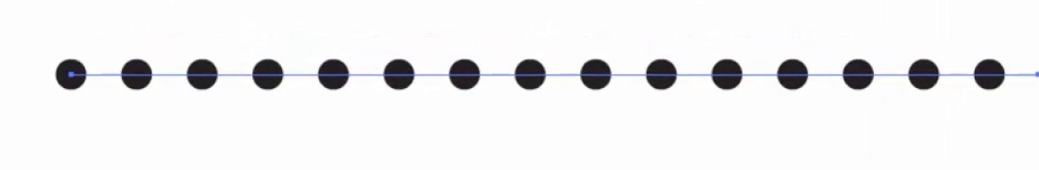



Background | Software Supply Chain
The software supply chain
Links
Software
Product
The chain is composed of
Actors
Artifacts
Operations
Notes:
A software supply chain is made-up activities linked together to produce and deliver a software product.
The chain comprises of 3 main components – Actors manipulate artifacts and operations within the supply chain to produce an output. Artifacts include the third-party libraries, product team's code, software infrastructure, and dependencies. Operations are productive steps such as fetching dependencies or compiling software, building the source code, and publishing steps such as deployment or distribution.
An actor controlling any step in the supply chain can intentionally or maliciously sabotage downstream users hence the essence of supply chain security which aims to protect these components and ensure that the final software product is tamper-free.

Slide 4

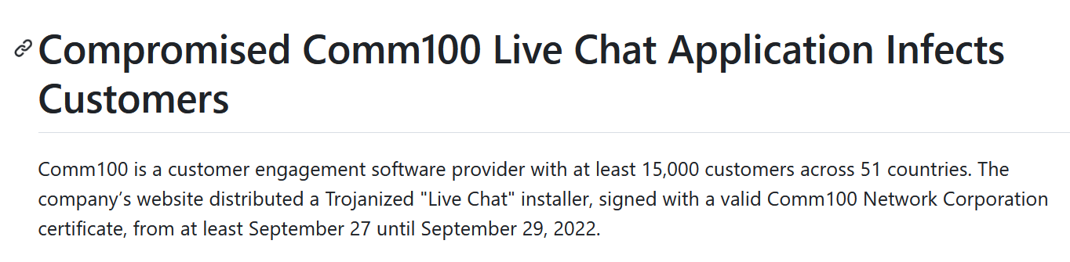
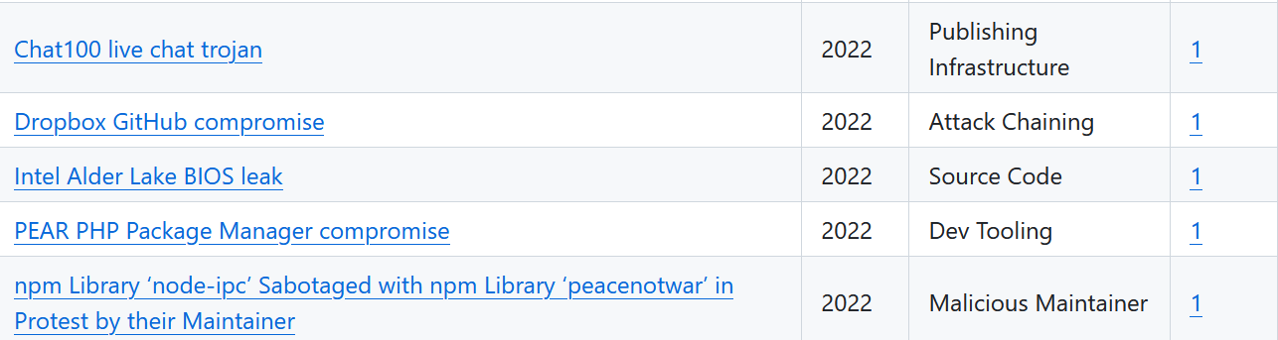
Background| Manual labeling—CNCF
Articles/blogs are collected, taxonomized and manually labeled
69 Articles about failures from the last 20 years
Labeled the type of compromise and brief description
Notes:
The data we used for our project is from CNCF called Catalog of Supply Chain Compromises. It consists of 69 failures from the last 20 years that have been manually labelled for the type of compromise. There is also a brief description about the failure. The QR code takes you to the git repo.

Slide 5
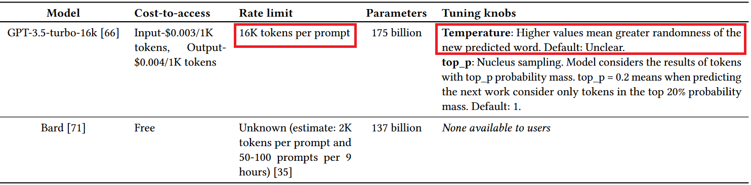


Background | Large Language Models (LLMs)
Trained on vast amount of data to understand context and product content
Useful in text generation, semantic search, and text analysis
Accessed on 10th July 2023
Notes:
Large Language Models or LLMs are designed to predict the next word. They are based on transformers, like neural networks but they carry context.
These been leveraged for various phases of the Software Development Life-Cycle (SDLC). LLMs are especially useful in text generation, semantic search, and text analysis. We used 2 LLMs in our paper- GPT-3.5 and Bard.
Introduce these LLMs.

Slide 6

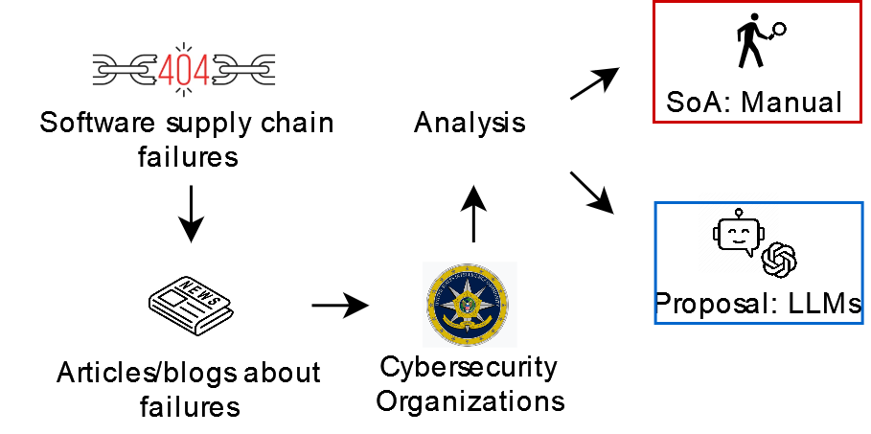
Idea
RQ1: How effective are LLMs in replicating manual analysis of software supply chain failures?
RQ2: Do LLMs suggest viable mitigation strategies for preventing future failures?
Notes:
With the goal of reducing the costs of manual analysis, we assess the effectiveness of Large Language Models (LLMs) in gathering
open-source intelligence. We explored the effectiveness of LLMs at replicating the classifications of the CNCF catalog made by Geer et al. and the CNCF catalog maintainers.
We explored two Research Questions.

Slide 7
Methods
Find relevant material (articles/blogs) on different failures- CNCF
Perform manual analysis for additional dimensions
Try to replicate this analysis using LLMs
Evaluate whether LLMs can be used for analysis
Notes:
The process we followed to answer our research question is as follows. First, we found appropriate data to analyze. This is the catalog I introduced earlier. However, this catalog just contained the type of failure and we expanded this with a few more dimensions. Then we conducted prompt engineering to replicate this analysis using LLMs. And finally, we collected the results, analyzed them and evaluated whether LLMs are a viable replacement for humans in analyzing supply chain failures.

Slide 8
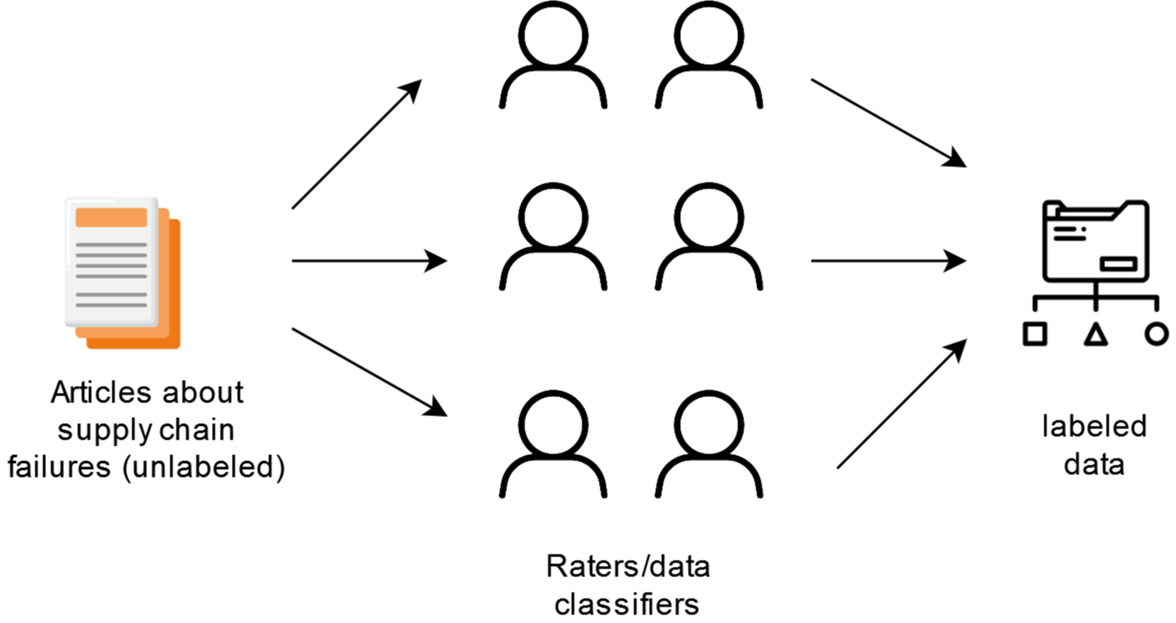
Methods | Manual analysis
Research Question 1
    Type of compromise- CNCF catalog
    Intent
    Nature
    Impacts
Research Question 2
  Solutions/Learnings
Labeling done by 6 raters
Notes:
We had 4 dimensions to analyze RQ1. Firstly, the type of compromise which was prelabeled in the CNCF catalog. We extended this by classifying each article by intent- whether the failure was deliberate or accidental. Next, we included the nature of the failure. Whether the failure was vulnerability which not exploited or an attack. Moreover, whether it was an attack from outsider or insider. Furthermore, we included impacts. This contained 6 options. I won’t go through all of them, but they are available in the bonus slides.
For RQ2, we asked the LLM to provide the solutions/learnings from these failures to prevent future failures. This was not taxonomized. However, we went through the responses and rated them on a scale of (1-5).
This process was done by a total of 6 raters. We divided the articles into 3 groups of 2.

Slide 9
Methods | Replicating analysis—prompt engr.
Providing context
Reflection Pattern
Template Technique
Cognitive Verifier Pattern
Adopt a persona
Citing evidence
White, Jules, et al. "A prompt pattern catalog to enhance prompt engineering with chatgpt." arXiv preprint arXiv:2302.11382 (2023).
White, Jules, et al. "Chatgpt prompt patterns for improving code quality, refactoring, requirements elicitation, and software design." arXiv preprint arXiv:2303.07839 (2023).
Notes:
We conducted extensive prompt engineering using the techniques listed here. Mention the techniques. I will explain these further in the coming slides. So, the accuracy of the prompts changed as seen on the graph. The graph is for the dimension- type of compromise. We then used the prompt with the highest accuracy.

Slide 10
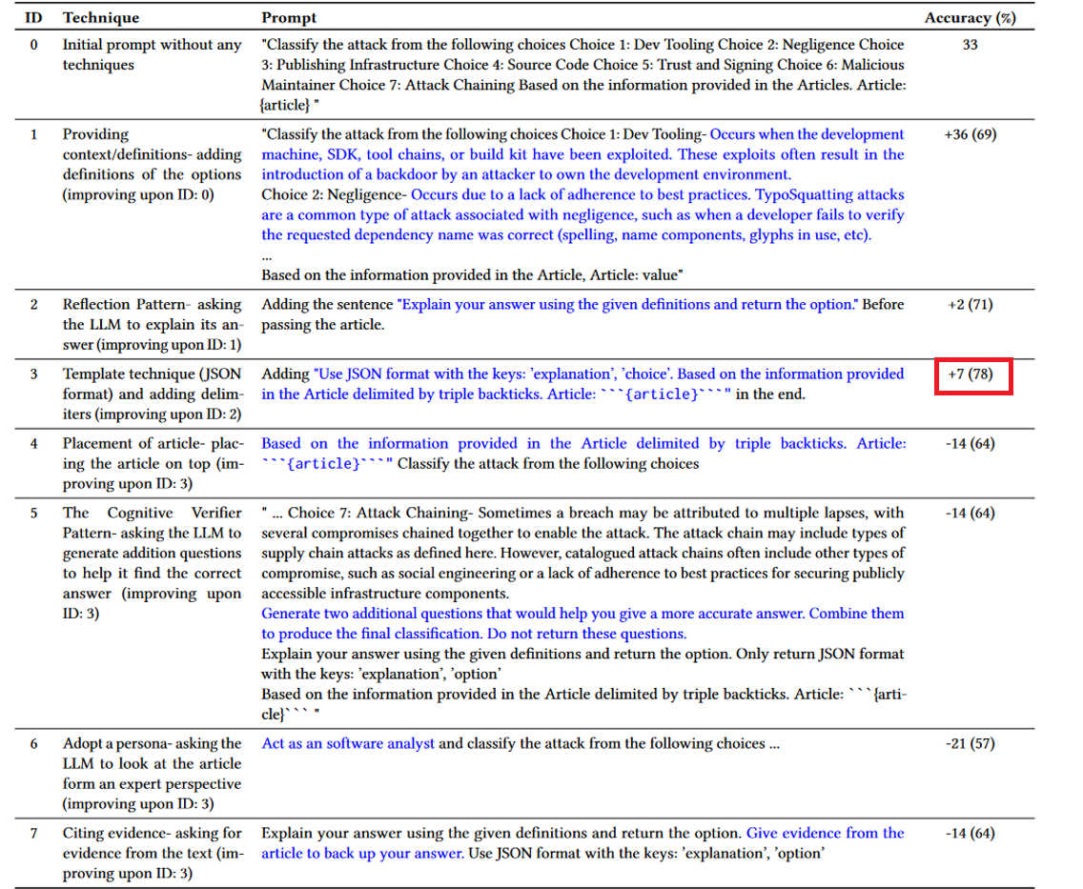
Methods | Replicating analysis—prompt engr.
Notes:
So I will now explain some of the techniques the rest are in bonus slides. Explain the techniques and talk about the accuracy.

Slide 11
Results | Kappa score and accuracy of LLMs
Trend: High accuracy when inter-rater agreement (Cohen's κ) is high
GPT 3.5 is equal or better for all dimensions
Overall, accuracy is not high enough to replace humans
Dimension | Agreement (Cohen’s κ) | GPT 3.5 | Bard
Type of compromise | Taken as ground truth from CNCF catalog | 59% | 28%
Intent | 0.87 (Group 1- 0.88, Group 2- 1, Group 3 – 0.77) | 88% | 88%
Nature | 0.58 (Group 1- 0.60, Group 2- 0.58, Group 3 – 0.55) | 74% | 69%
Impacts | 0.34 (Group 1- 0.51, Group 2- 0.32, Group 3 – 0.20) | 52% | 45%
Notes:
These are the results we gathered for the first RQ.
Read out the table.
There is a clear trend here, as the kappa score of the dimensions decreases so does the accuracy of LLMs. So, when the humans are confused about labeling, so is the LLM.
GPT proved to be better or equal in all dimensions.
However, we could not conclude that the overall accuracy was high enough to replace humans.

Slide 12
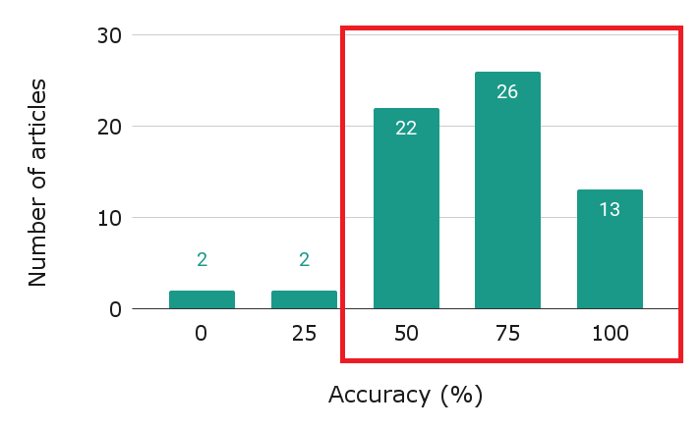
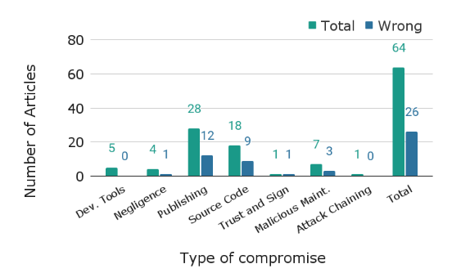
Results | Further GPT analysis
Most articles had an accuracy of 50% or higher
Articles with low accuracy contained insufficient information
No clear trend for the inaccuracies/error in the type of compromise dimension
Notes:
Here are some additional results.
Most of the articles had an accuracy of over 50%. Only 4 articles had an accuracy under 50%.
These articles had insufficient information for labelling.
The inaccuracies did not follow a trend in any of the dimensions.
The graph here shows the inaccuracies for the dimension- type of compromise. As you can see there is not enough evidence to say that there is a trend where the LLMs perform better.

Slide 13
Results | Further GPT analysis—Solutions
Ratings based on a 5-point Likert scale
42% of the ratings were above 4 (agree), and only 5% of the ratings fell below 2 (disagree)
More detailed and specific answers when articles contained technical analysis/solutions
Generic answers when articles contained less information
GPT can provide reasonable solutions
Question | Rating
Is the advice helpful in general for software supply chain failures? | 3.72
Is the advice related to the specific failure mentioned in the article? | 4.15
Can the advice be used to solve/mitigate the failure mentioned in the article? | 3.62
Notes:
For the second RQ, we explored the capabilities of GPT to use its knowledge alongside the information provided in the articles to generate solutions/learning from the failures to prevent future failures. After getting the advice from the LLM, we asked raters 3 questions on the advice. The average ratings for these questions over the 69 articles listed in the table below.
Talk about the other bullet points.

Slide 14
Discussion/Future Work
Are LLMs worth it in this context?
Will LLMs be a viable alternative to manual analysis in the future?
Notes:
We found that both LLMs in our experiment were capable of simpler forms of analysis, such as distinguishing whether a vulnerability was exploited. However, for more complex questions that require some amount of context or judgment, neither LLM achieved a high level of agreement with the CNCF analysts or our manual raters.
In the past few years, OpenAI's GPT models have advanced from simple tasks (GPT-1, GPT-2) to the performance reported here (GPT-3.5).The recent GPT-4 model is more impressive still. We expect the next generation of LLMs will be suitable aids or replacements for this class of manual analysis.

Slide 15


Conclusion
Powerful with high inter-rater agreement and detailed articles
At this stage, cannot replace human labeling and analysis
Currently a useful tool that can evolve into analytical resource
Manuscript
Artifact
Thank you for your attention!
Notes:
Our study revealed that LLMs are particularly effective when manual analysts are able to reach a consensus on the characteristics of the failure. In contrast,
their performance tends to deteriorate when the agreement among raters is low. The quality of the LLMs’ outputs also depends on the
level of detail provided in the source articles, with more comprehensive articles leading to higher-quality responses. We conjecture that
while LLMs offer a valuable tool for rapidly analyzing large volumes of text, they have not yet reached a stage where they can replace
human analysts or manual classification. Rather than viewing LLMs as a replacement for human input, they should be considered as a
supplementary tool that can assist human analysts. As the depth of detail in postmortems and articles increases, and as LLMs continue
to improve, they may evolve into viable analytical resources.

Slide 16
Bonus Slides

Slide 17
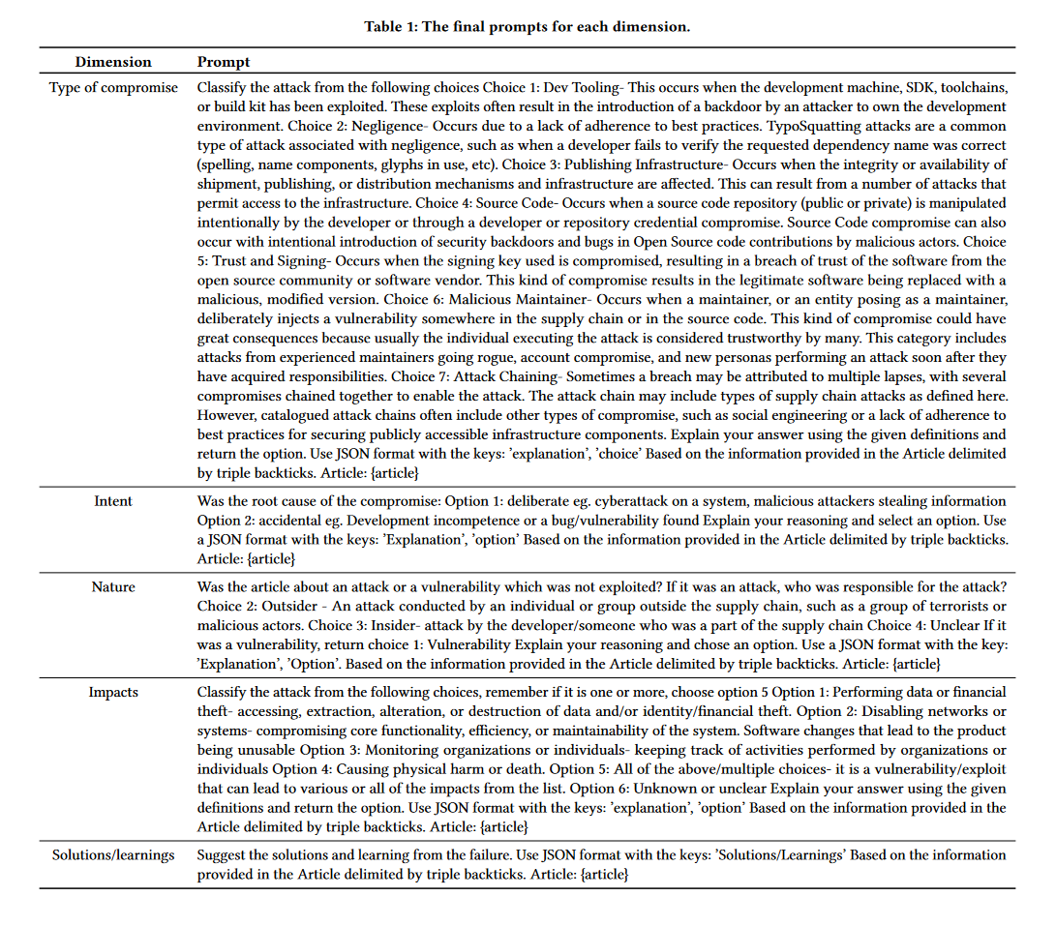
Methods | prompts for the dimensions

Slide 18
Methods | prompts for the dimensions

Slide 19
Methods | Replicating analysis- prompt engr.

Slide 20
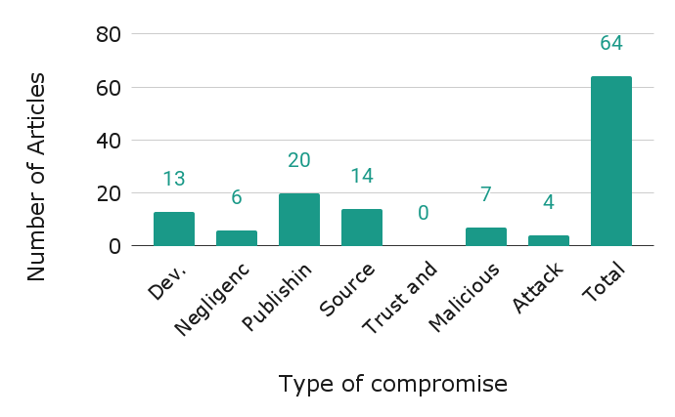
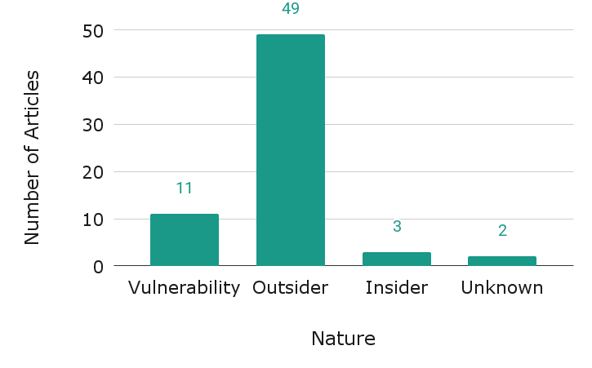
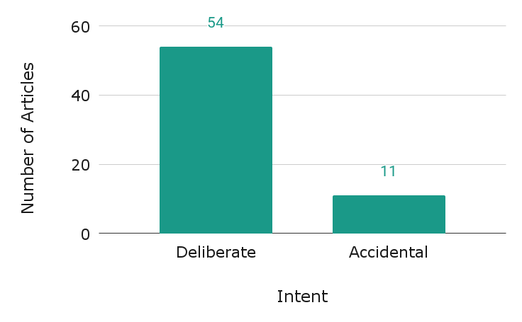
Distribution of Ground Truth/manual analysis

Slide 21
Limitations
Prompt engineering was only conducted for GPT 3.5
Prompts could be over-fitted to analysis in the catalog

Slide 22
Disagreements with CNCF
We labeled a set of articles for the type of compromises
Alerted CNCF about the labeling of the articles we disagreed with

